Slide 1
Efficient Decentralized Communication in Large-Scale
Multi-Agent Systems
①
②
③
A Decentralized Communication Framework based on Dual-Level Recurrence for Multi-Agent Reinforcement Learning
Fully Decentralized Multiagent Communication via Causal Inference
Learning Communication for Cooperation in Dynamic Agent-Number Environment
④
⑤
Communication-Efficient Decentralized Multi-Agent Reinforcement Learning for Cooperative Adaptive Cruise Control
NVIF: Neighboring Variational Information Flow for Cooperative Large-Scale Multiagent Reinforcement Learning
CPS Computational Learning Laboratory
Notes:
大规模多智能体系统中的高效通信
基于双层循环的多智能体强化学习去中心化通信框架
基于因果推理的完全去中心化多智能体通信
动态智能体数环境下的协同学习通信
用于协同自适应巡航控制具有高效通信的去中心化多智能体强化学习
用于协同大规模多智能体强化学习的邻域变分信息流

Slide 2

②
①
Fully Decentralized Multiagent Communication via Causal Inference
A Decentralized Communication Framework based on Dual-Level Recurrence for Multi-Agent Reinforcement Learning
Decentralized MARL
Large-scale MASs
④
③
⑤
Communication-Efficient Decentralized Multi-Agent Reinforcement Learning for Cooperative Adaptive Cruise Control
Learning Communication for Cooperation in Dynamic Agent-Number Environment
NVIF: Neighboring Variational Information Flow for Cooperative Large-Scale Multiagent Reinforcement Learning
Efficient Communication
CPS Computational Learning Laboratory

Slide 3
Paper 1
A Decentralized Communication Framework based on Dual-Level Recurrence for Multi-Agent Reinforcement Learning
Xuesi Li, Jingchen Li, Haobin Shi, and Kao-Shing Hwang, Senior Member, IEEE
This paper was published in: IEEE Transactions on Cognitive and Developmental Systems
Published Time: 2024
Reference: X. Li, J. Li, H. Shi and K. -S. Hwang, "A Decentralized Communication Framework Based on Dual-Level Recurrence for Multiagent Reinforcement Learning," in IEEE Transactions on Cognitive and Developmental Systems, vol. 16, no. 2, pp. 640-649, April 2024, doi: 10.1109/TCDS.2023.3281878.
CPS Computational Learning Laboratory
Notes:
基于双层循环的多智能体强化学习分布式通信框架

Slide 4
01
Problem Description
02
Method Design
03
Experiment Results
Contents
04
Conclusion
CPS Computational Learning Laboratory
Notes:
主要分为以下四个部分

Slide 5
01
Problem Description
02
Method Design
03
Experiment Results
Contents
04
Conclusion
CPS Computational Learning Laboratory
Notes:
主要分为以下四个部分

Slide 6
Problem Description
Challenge:
The existing communication mechanisms still have limitations. State integration modules result in a massive communication network for a too-large multi-agent system.
No work has been devoted to introducing attention-based recurrent models into multi-agent communication
Method:
dual-recurrent communication model (2ReCom)
We discuss the challenges in multi-agent communication, proposing a dual-recurrent communication model to enable multi-agent deal changeable communication objects.
To reduce the impacts of communication information on individual memories of agents, We propose an attentionbased recurrent network to conduct communication in our model. Benefiting from the attention mechanism, the proposed recurrent model can guarantee the communication qualities.
CPS Computational Learning Laboratory
Notes:
这篇文章针对的问题是：现有的通信机制的状态集成模块会导致其在大规模多智能体系统中产生巨大的通信网络。我对这句话的理解就是在训练大规模异构多智能体系统时，所建立的通信模块不能彼此共享参数，导致庞大的训练结构。
第二点是还没有工作致力于将基于注意力的循环模型引入多智能体通信。
这篇文章提出的方法叫双循环通信模型2recom，这种方法使多智能体能够处理不断变化的通信对象。具体来说，这篇文章提出了一种基于注意力的递归网络来进行通信，从而减少通信信息对智能体个体记忆的影响，保证通信质量。

Slide 7
01
Problem Description
02
Method Design
03
Experiment Results
Contents
04
Conclusion
CPS Computational Learning Laboratory
Notes:
研究现状

Slide 8
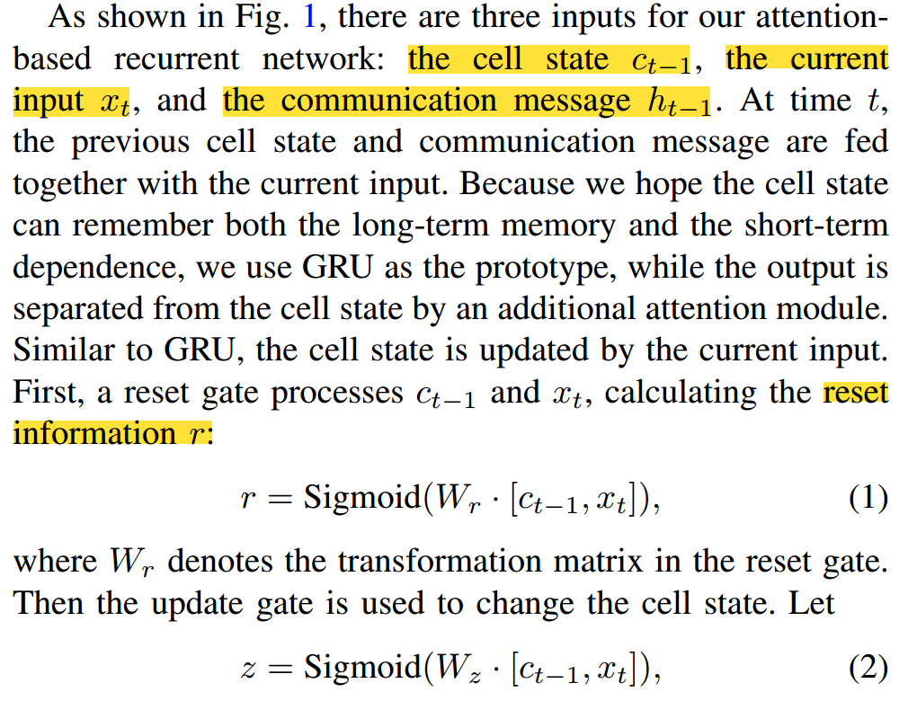
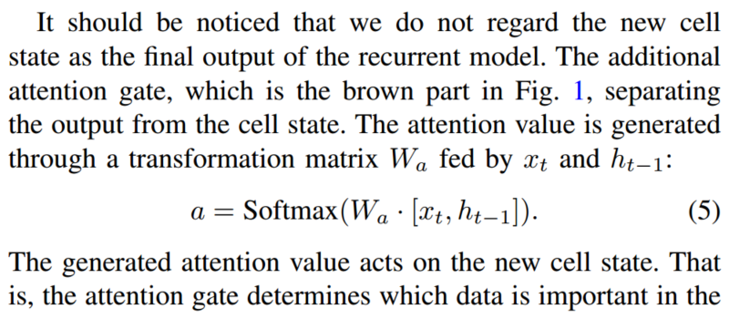
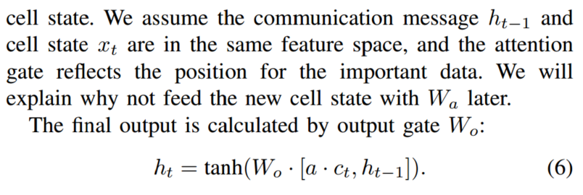
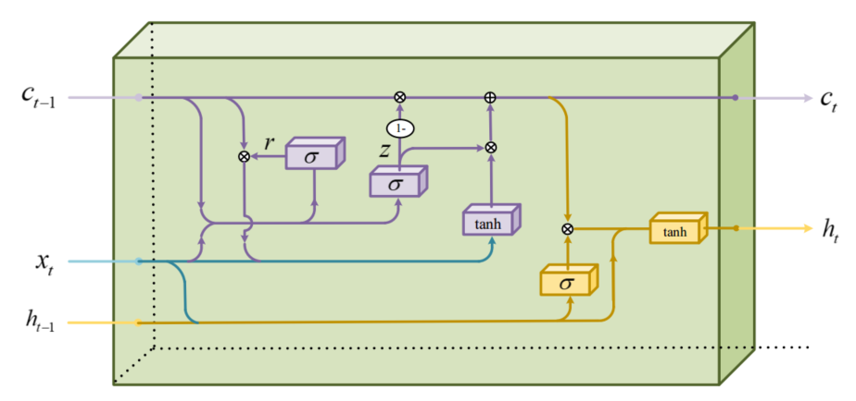
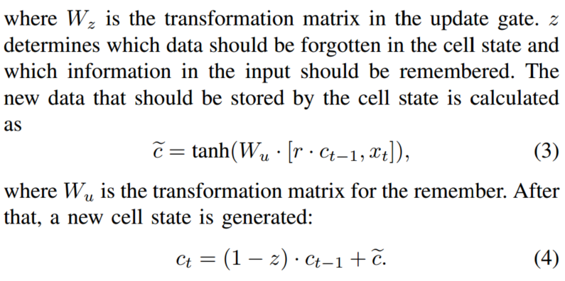
Method Design
Gated Recurrent Model for Communication
CPS Computational Learning Laboratory
Notes:
首先是第一个点，叫做用于通信的门控循环模型，就是在GRU的基础上加了一个注意力机制，如右下角图所示。
这种门控循环模型有三个输入：细胞状态ct-1、当前输入xt和通信消息ht-1。其中这个当前输入在这篇论文里就是智能体i观测的编码特征。在时间t，上一时刻细胞状态、通信消息与当前观测编码特征一起输入到这个门控循环模型中。
首先，复位门处理ct-1和xt，计算复位信息r，如公式1所示。更新信息z如公式2所示，z决定了单元格状态中哪些数据应该被遗忘，哪些输入中的信息应该被记住。应该存储的新数据c波浪如公式3所示，下一时刻的细胞状态如公式4所示。计算当前输入x与上一时刻消息h之间的注意力系数，如公式5所示，最后利用公式6生成当前时刻消息。
这种架构中，状态ct存储的是当前智能体的历史信息。虽然消息ht的产生会需要ct，但是ht与ct分离，ht不影响ct，因此作者认为智能体发送的消息不会影响智能体自身的历史信息。这篇文章的作者认为这种不影响历史信息的通信机制可以适用于通信对象不断变化的多智能体系统，通信具有鲁棒性。

Slide 9
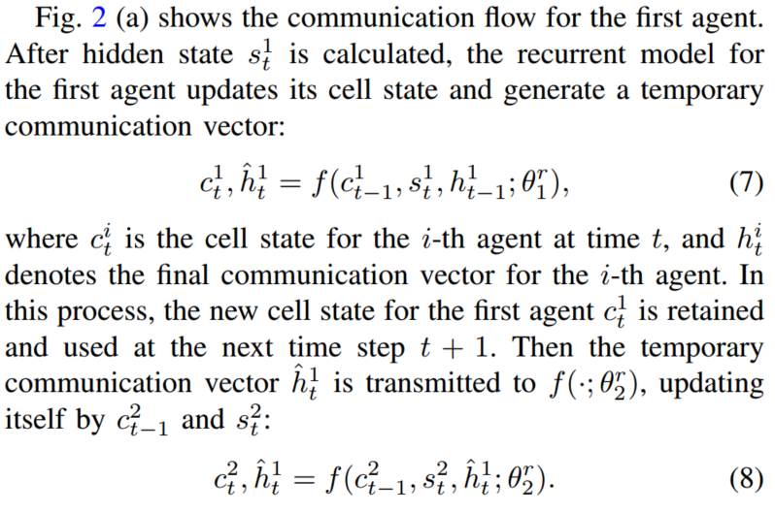
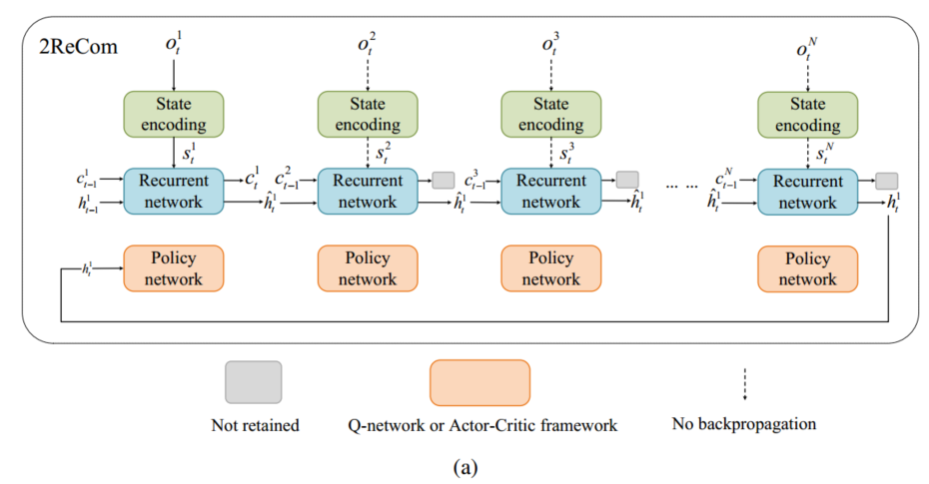
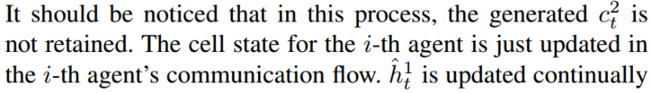
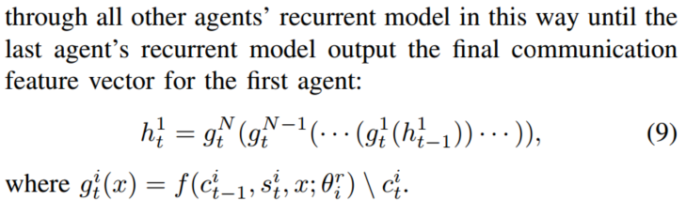
Method Design
Dual-Recurrent Communication
CPS Computational Learning Laboratory
Notes:
第二个点就是这个双循环通信，如图a所示。图s是对智能体1进行分析，智能体1根据自身上一时刻细胞状态ct-1，当前时刻观测编码结果st也就是上一个点中的xt，以及上一时刻通信消息ht-1输入到门控循环模型中，得到一个临时的消息hhat和当前时刻的细胞状态c1t，如公式7所示。然后把公式7得到的临时消息hhat，利用公式8，输入到智能体2的循环网络中，将临时消息再次编码，然后把消息输入到智能体3中，以此类推，公式9展示了临时消息hhat经过所有智能体的循环网络编码后的最终消息，最终消息输入到智能体1的策略网络中，如图a所示。

Slide 10
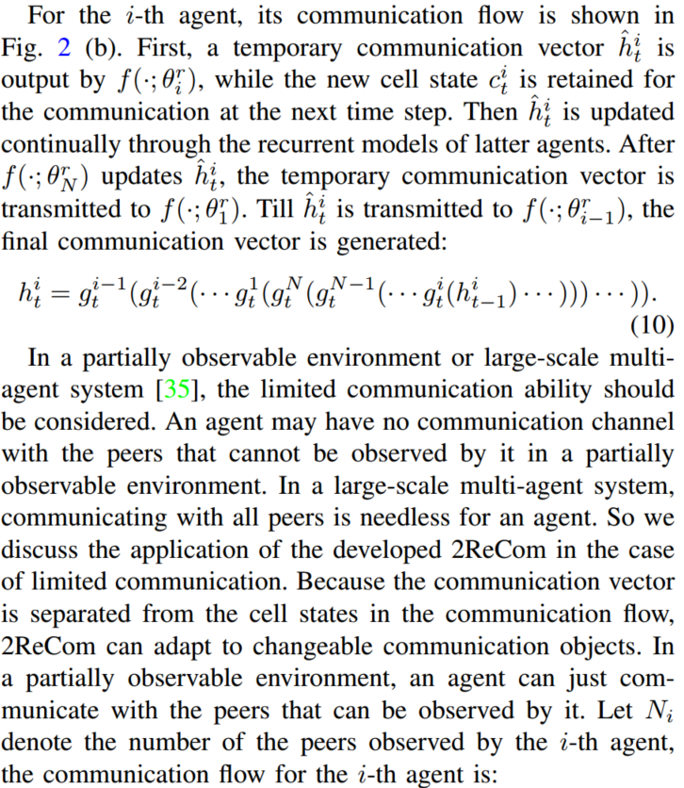
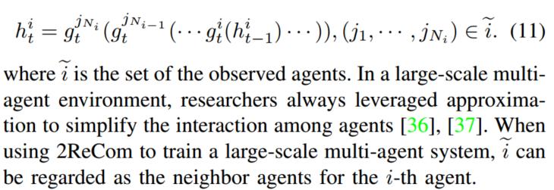
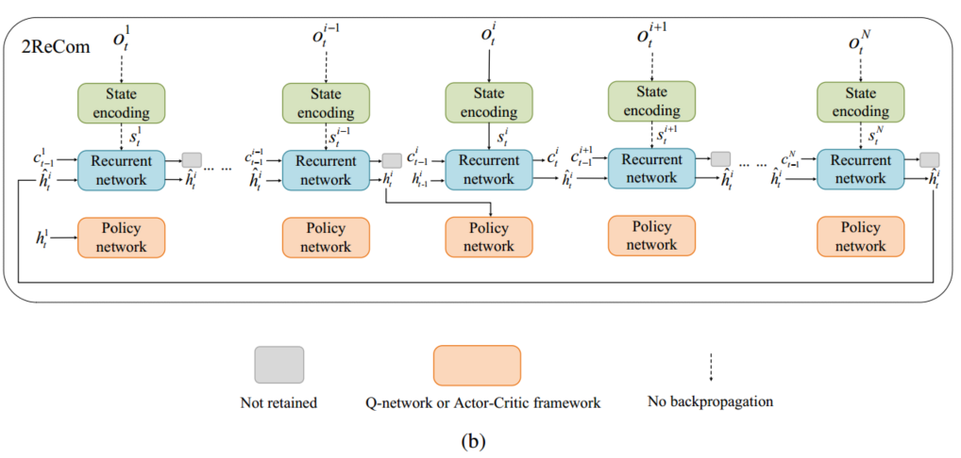
Method Design
CPS Computational Learning Laboratory
Notes:
公式10将公式9中的表述从智能体1扩展到任意智能体i。上述为完全可观测的表达式，在部分可观测环境中，智能体可能只能观测到自身一定范围内的智能体，这篇文章的作者把公式10扩展到部分可观测的环境中，得到公式11，

Slide 11
01
Problem Description
02
Method Design
03
Experiment Results
Contents
04
Conclusion
CPS Computational Learning Laboratory

Slide 12
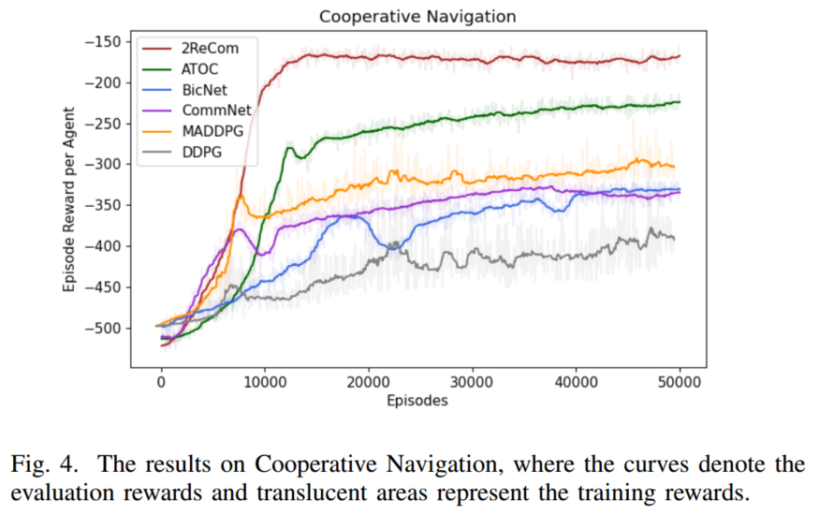
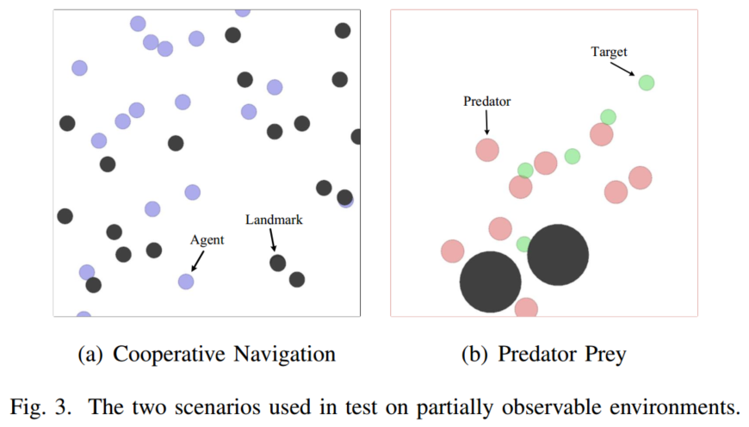
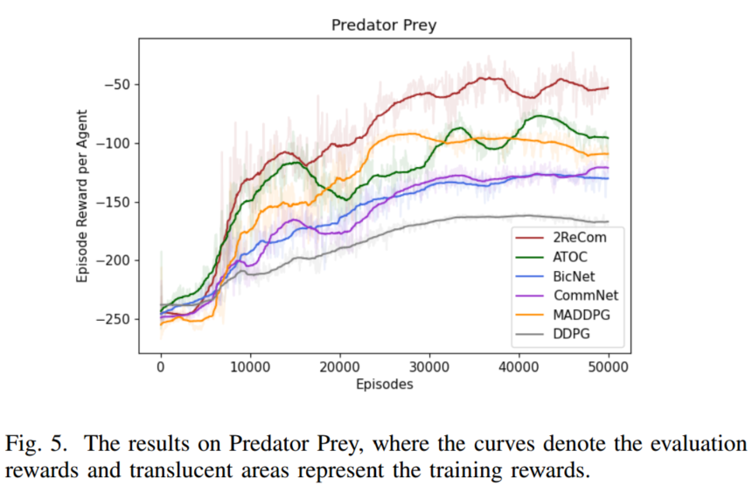
Experiment Results
CPS Computational Learning Laboratory
Notes:
密集奖励

Slide 13
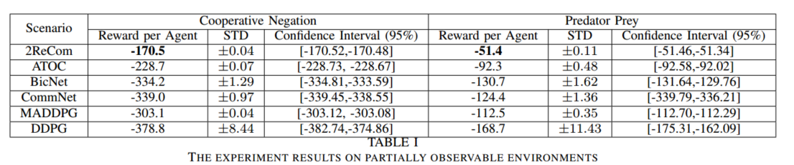
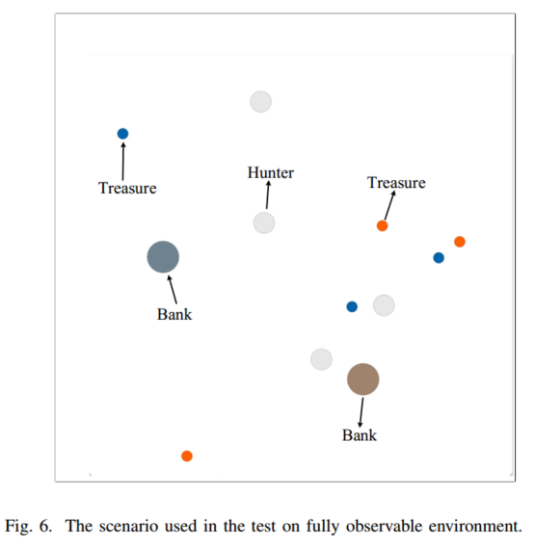
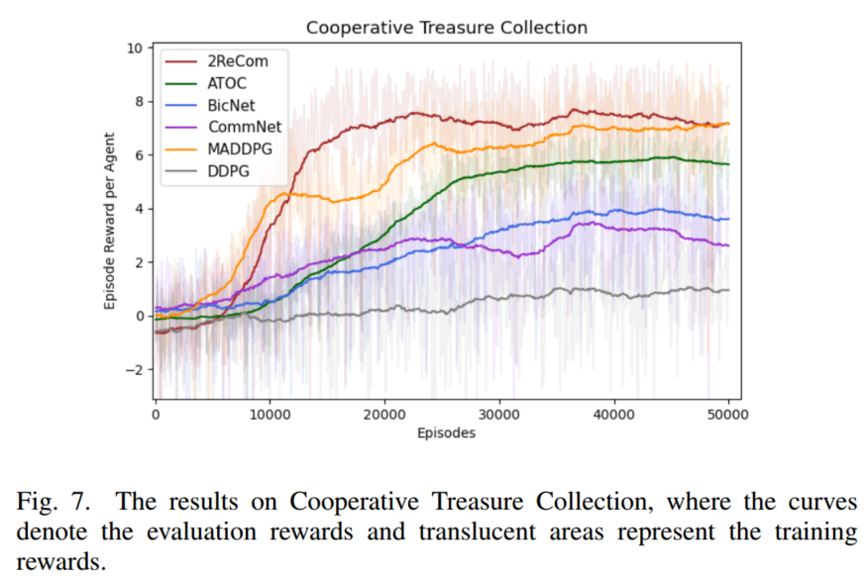
Experiment Results
CPS Computational Learning Laboratory

Slide 14
01
Problem Description
02
Method Design
03
Experiment Results
Contents
04
Conclusion
CPS Computational Learning Laboratory
CPS Computational Learning Laboratory
2
18
Notes:
最后一部分是未来工作

Slide 15
Conclusion
①
In this work, we develop a new communication framework for decentralized multi-agent reinforcement learning. Our 2ReCom has two main superiorities: We regard historical states of agents as a part of communication information, proposing a dual-recurrence for decentralized multi-agent systems; the developed 2ReCom separates communications from memories, making agents adapt to changeable communication objects.
②
In future work, we will improve 2ReCom step by step, aiming at rivaling the start-of-the-art centralized learning method.
CPS Computational Learning Laboratory
Notes:
这篇文章开发的2ReCom具有两个主要优势：将智能体的历史状态视为通信信息的一部分，提出了去中心化多智能体系统的双重循环通信架构；2ReCom将通信与记忆分离，使智能体适应不断变化的通信对象。
未来作者希望不断改进2recom，使其的性能比肩最先进的集中式学习方法。

Slide 16
Paper 2
Fully Decentralized Multiagent Communication via Causal Inference
Han Wang , Yang Yu , and Yuan Jiang
This paper was published in: IEEE Transactions on Neural Networks and Learning Systems
Published Time: 2023
Reference: H. Wang, Y. Yu and Y. Jiang, "Fully Decentralized Multiagent Communication via Causal Inference," in IEEE Transactions on Neural Networks and Learning Systems, vol. 34, no. 12, pp. 10193-10202, Dec. 2023, doi: 10.1109/TNNLS.2022.3165114.
CPS Computational Learning Laboratory
Notes:
基于因果推理的完全去中心化多智能体通信

Slide 17
01
Problem Description
02
Method Design
03
Experiment Results
Contents
04
Conclusion
CPS Computational Learning Laboratory

Slide 18
01
Problem Description
02
Method Design
03
Experiment Results
Contents
04
Conclusion
CPS Computational Learning Laboratory

Slide 19
Problem Description
Many real-world tasks can be cast into multiagent reinforcement learning (MARL) problems, and most algorithms in this field obey to the centralized learning and decentralized execution framework. However, enforcing centralized learning is impractical in many scenarios. Because it requires integrating the information from agents, while agents may not hope to share local information due to the issue of privacy.
This article proposes a novel approach to achieve fully decentralized learning based on communication among multiple agents via RL. Benefiting from causality analysis, an agent will choose the counterfactual that has the most significant influence on communication information of others.
CPS Computational Learning Laboratory
Notes:
现实世界中的许多任务都可以转化为多智能体强化学习问题，这一领域的大多数算法都遵循集中式学习和分散式执行的框架，但集中式学习在很多情况下是不切实际的，因为集中式学习需要集成来自智能体的信息，而智能体由于隐私问题可能不希望共享本地信息
这篇文章提出了一种新的基于多智能体通信的去中心化学习方法，该方法通过强化学习来实现完全去中心化学习，利用因果分析，智能体将选择对其他智能体通信信息影响最大的反事实。

Slide 20
01
Problem Description
02
Method Design
03
Experiment Results
Contents
04
Future Work
CPS Computational Learning Laboratory
Notes:
研究现状

Slide 21
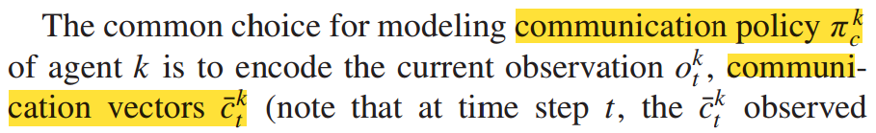
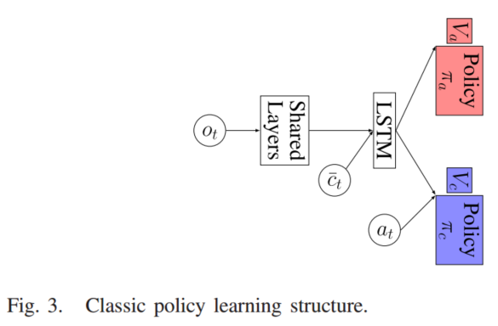
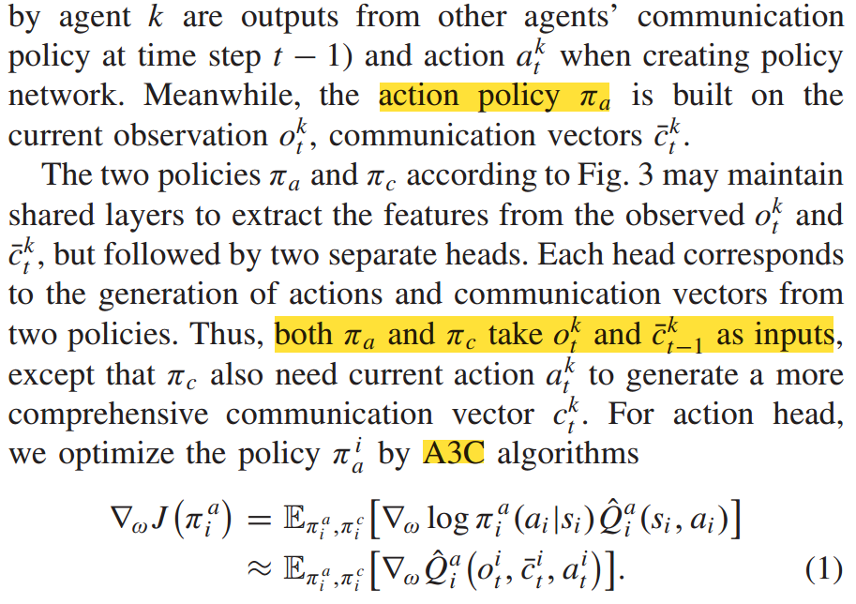
Method Design
Communication Framework
CPS Computational Learning Laboratory
Notes:
如图3所示，这篇文章的策略有两个端的输出，一个是pia，也就是普通的策略网络模型，也就是图3中的红色部分。这篇文章在此基础上，又建立了一个通信策略pic，也就是图3中的蓝色部分。我先对图3进行一个简单的描述，观测经过一个共享的神经网络层编码，并将编码后的特征与通信向量c-拼接输入到一个LSTM网络中，LSTM网络的输出分别通过动作策略以及通信策略得到下一时刻的动作以及通信向量。

Slide 22
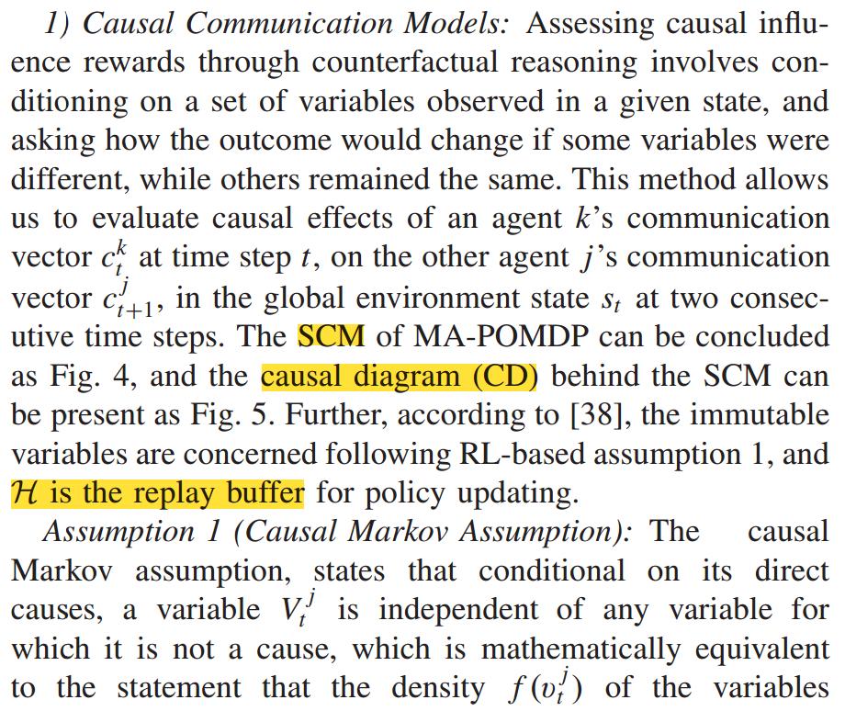
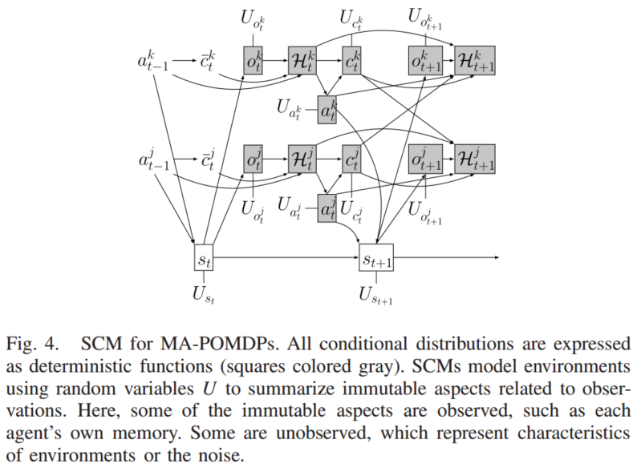
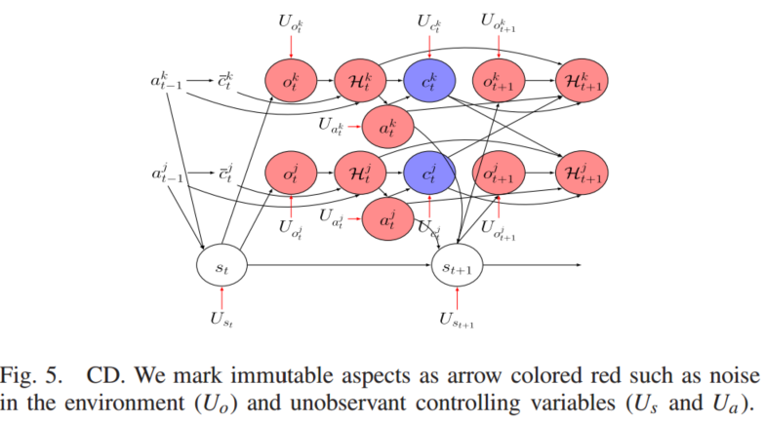
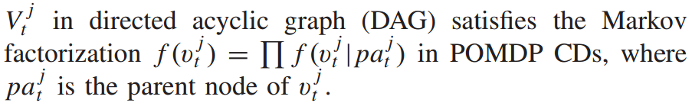
Method Design
Counterfactual Policy Update
CPS Computational Learning Laboratory
Notes:
接下来介绍反事实策略更新
首先这篇文章提出了一种因果推理模型，简称CCM。这个SCM全称叫做结构因果模型，可能是因果推理领域的知识吧。多智能体部分可观测马尔可夫决策过程如图4所示，结构因果模型的因果图如图5所示。这里由于我不懂因果推理领域的知识，图4和图5我看的不是很懂，但是我大概理解它的意思，我根据他这篇文章上下文之间的联系，我认为这里其实是在建立任意两个不同的智能体的通信向量在前后两个连续时刻的关系。

Slide 23
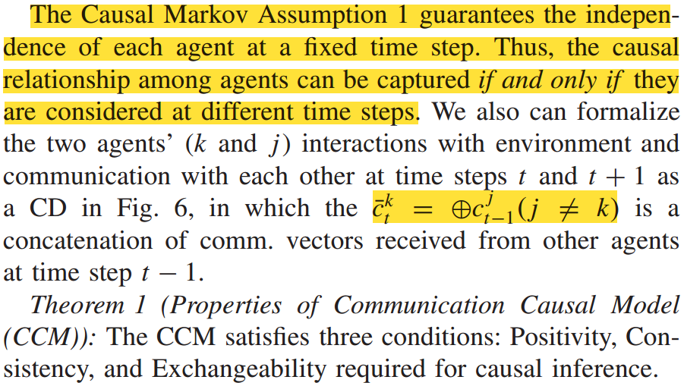
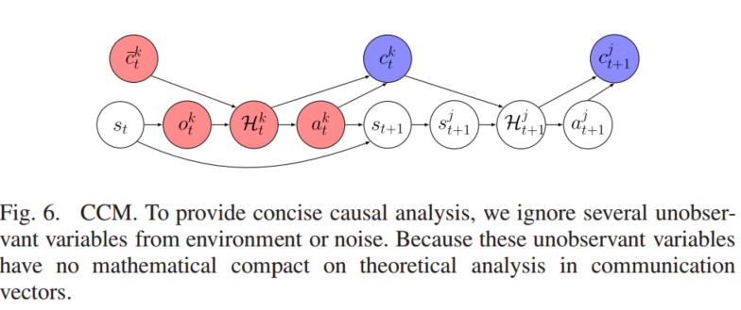
Method Design
CPS Computational Learning Laboratory
Notes:
这里也验证了我刚刚的理解，也就是说它的假设1因果马尔可夫决策过程保证了每个智能体在固定的时间步上的独立性，当且仅当在不同的时间步时智能体之间才具有因果联系。也就是说，他希望获取不同时间步中任意智能体之间的联系。他下面的操作也验证了我的观点。
这篇文章将智能体k和智能体j在时间步t和t + 1通信联系表述为因果图，如图6所示。这就是在建立不同时间步通信的联系

Slide 24
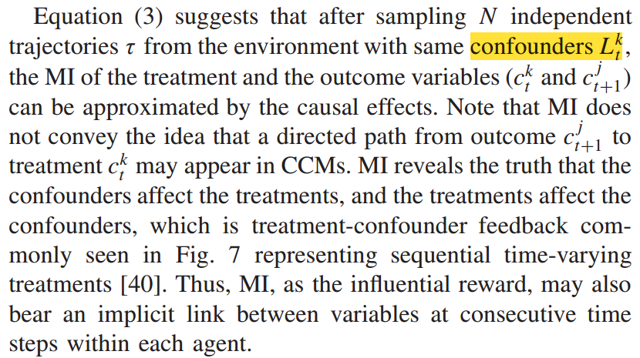
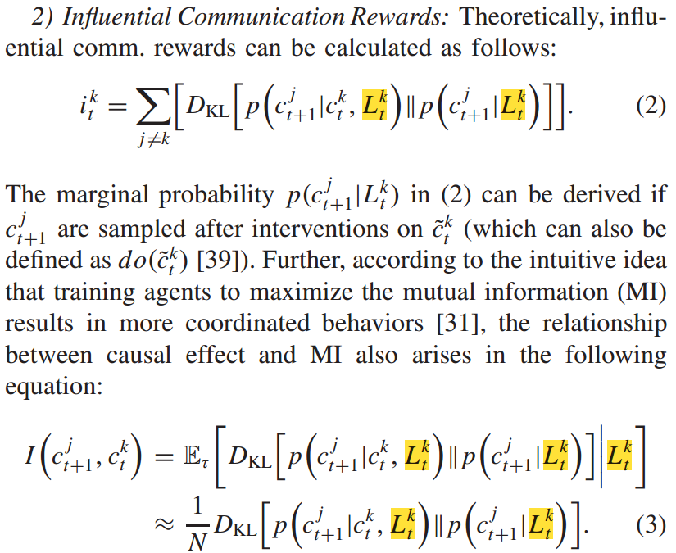
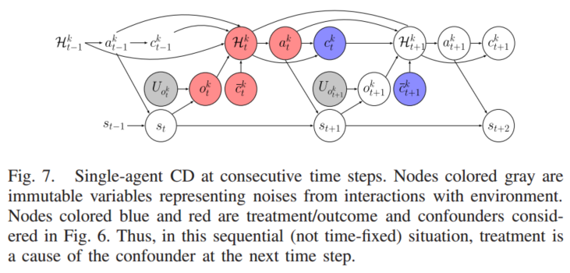
Method Design
CPS Computational Learning Laboratory
Notes:
第二个点时有影响力的通信奖励，计算方式如公式2所示，其中L代表反事实。公式2实际上就是计算了智能体k的通信向量对智能体j通信向量的影响程度，这篇论文本质上做的东西跟我研究点二中的创新点3是一个东西，但是它用因果推理的知识解释了智能体之间的影响。
但是他这样做有一个问题，就是这个通信向量被限制成一个概率分布了，要不然这KL散度没法计算，这一点又和我的方法不一样。然后这篇文章又把公式2改写成互信息的形式，如公式3所示，建立了因果关系与互信息之间的联系。

Slide 25
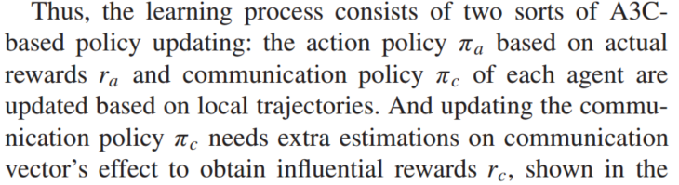
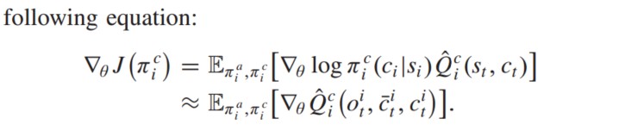
Method Design
CPS Computational Learning Laboratory
Notes:
最后是他这个方法中通信策略的更新方式，和之前的动作策略的更新方法一致，都是用A3C的损失函数

Slide 26
01
Problem Description
02
Method Design
03
Experiment Results
Contents
04
Conclusion
CPS Computational Learning Laboratory

Slide 27
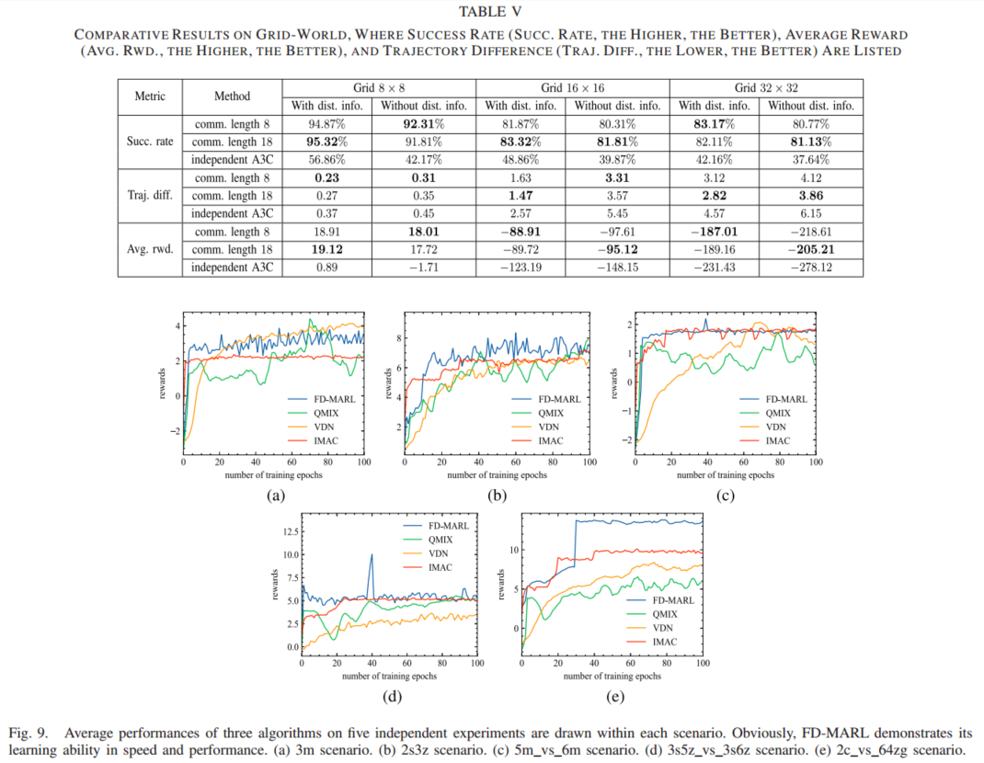
Experiment Results
CPS Computational Learning Laboratory

Slide 28
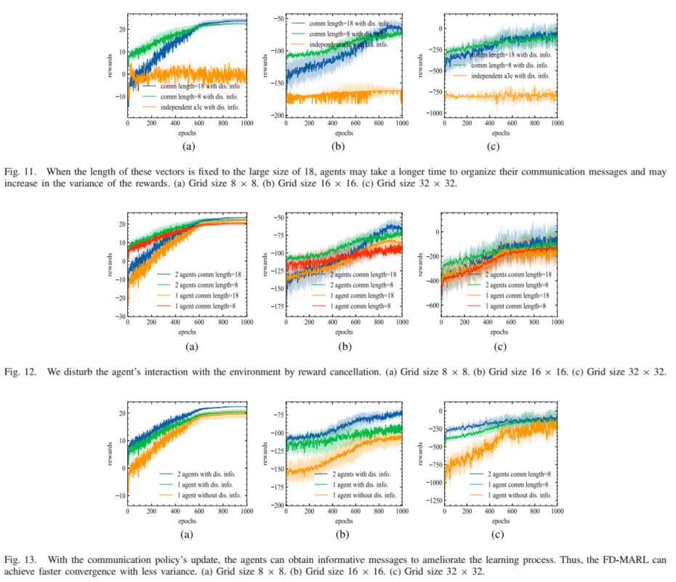
Experiment Results
CPS Computational Learning Laboratory

Slide 29
01
Problem Description
02
Method Design
03
Experiment Results
Contents
04
Conclusion
CPS Computational Learning Laboratory
CPS Computational Learning Laboratory
2
18

Slide 30
Conclusion
①
In this work, we introduced FD-MARL which aims to solve MA tasks in various cooperation settings by learning to communicate. FD-MARL allows agents to modify communication message by choosing the counterfactual that bears the most significant influence on others. Thus, the continuous communication based on causal analysis enables efficient information transformation in a fully decentralized manner.
②
In future, we would like to explore multi-channel causal communication. Thus, agents can adapt to new tasks by leveraging the domain-specific information contained in prior tasks.
CPS Computational Learning Laboratory
Notes:
这篇文章提出了了完全去中心化的MARL算法，通过学习沟通来解决各种协同环境下的多智能体任务，允许智能体通过选择对其他人影响最大的反事实来促进通信。作者希望未来能够探索多通道的因果通信。因此，智能体可以适应新的任务，利用特定领域的信息包含在先前的任务。

Slide 31
Paper 3
Learning Communication for Cooperation in Dynamic Agent-Number Environment
Weiwei Liu , Shanqi Liu, Junjie Cao , Qi Wang, Xiaolei Lang, and Yong Liu
This paper was published in: IEEE/ASME Transactions on Mechatronics
Published Time: 2021
Reference: W. Liu, S. Liu, J. Cao, Q. Wang, X. Lang and Y. Liu, "Learning Communication for Cooperation in Dynamic Agent-Number Environment," in IEEE/ASME Transactions on Mechatronics, vol. 26, no. 4, pp. 1846-1857, Aug. 2021, doi: 10.1109/TMECH.2021.3076080.
CPS Computational Learning Laboratory
Notes:
动态智能体数环境下的协同学习通信

Slide 32
01
Problem Description
02
Method Design
03
Experiment Results
Contents
04
Conclusion
CPS Computational Learning Laboratory
Notes:
问题描述，研究现状，方法设计，实验结果，未来工作

Slide 33
01
Problem Description
02
Method Design
03
Experiment Results
Contents
04
Conclusion
CPS Computational Learning Laboratory
Notes:
问题描述，研究现状，方法设计，实验结果，未来工作

Slide 34
Problem Description
Multiagent reinforcement learning (MARL) algorithms are limited to fixed network dimensions, and prior knowledge is used to preset the number of agents in the training phase, which leads to a poor generalization of the algorithm. In addition, these algorithms use centralized training to solve the instability problem of multiagent systems. However, the centralized learning of large-scale multiagent RL algorithms will lead to an explosion of network dimensions, which in turn leads to very limited scalability of centralized learning algorithms.
this article propose a group centralized training and decentralized execution-unlimited dynamic agent-number network (GCTDE-UDAN).
CPS Computational Learning Laboratory
Notes:
目前的多智能体强化学习（RL）算法大多局限于固定的网络维数，在训练阶段使用先验知识来预先设定智能体的数量，导致算法的泛化能力较差，另外，这些算法使用集中式训练来解决多智能体系统的不稳定问题。然而，大规模多智能体RL算法的集中式学习将导致网络维度的爆炸，这反过来又导致集中式学习算法的可扩展性非常有限。本文提出了一种群集中训练、分散执行的无限动态智能体数网络（GCTDE-UDAN）

Slide 35
01
Problem Description
02
Method Design
03
Experiment Results
Contents
04
Conclusion
CPS Computational Learning Laboratory
Notes:
研究现状

Slide 36
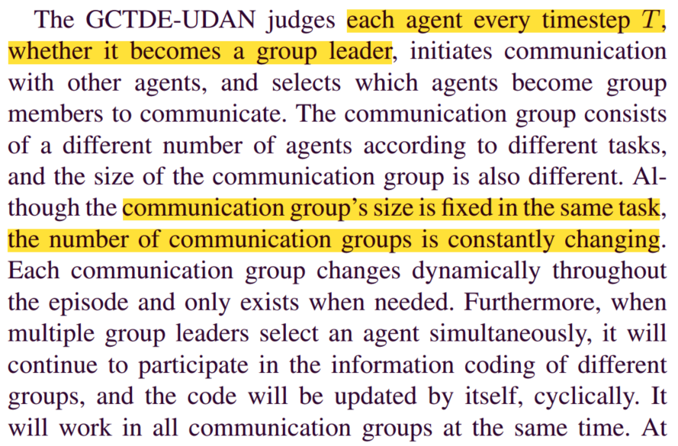
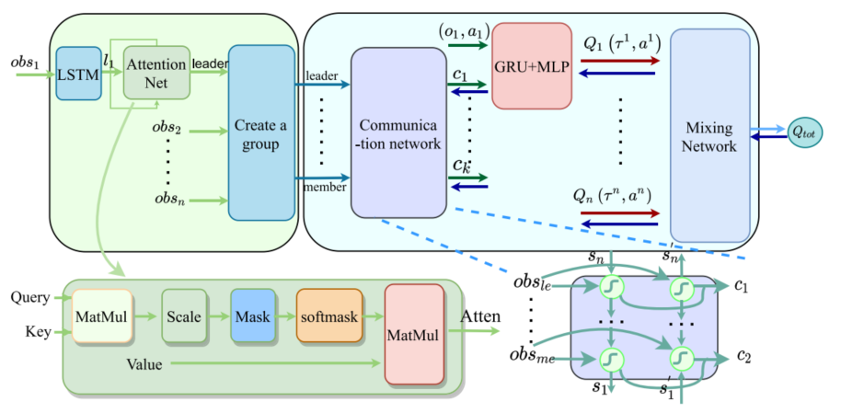
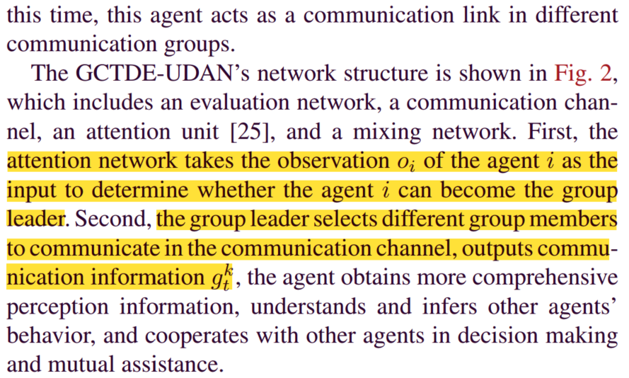
Method Design
CPS Computational Learning Laboratory
Notes:
该方法在每个时间步T判断每个智能体是否成为组长，选择哪些智能体成为组成员进行通信。每个通信组根据任务的不同由不同数量的智能体组成，而且通信组的数量不断变化。这是由于每一个通讯组都是动态变化的，只有在需要的时候才存在。
右图是这篇文章的方法架构，基于QMIX做的一个算法，包含注意力网络，通信网络，执行网络以及混合网络。其工作流程为：首先，将智能体i的观测oi输入到注意力网络中，判断智能体i是否能成为组长，其次，组长选择不同的组成员在通信通道中进行通信，输出通信信息，通信信息以及观测输入到每个智能体网络中，输出个体Q值，个体Q值通过混合网络输出联合Q值。

Slide 37
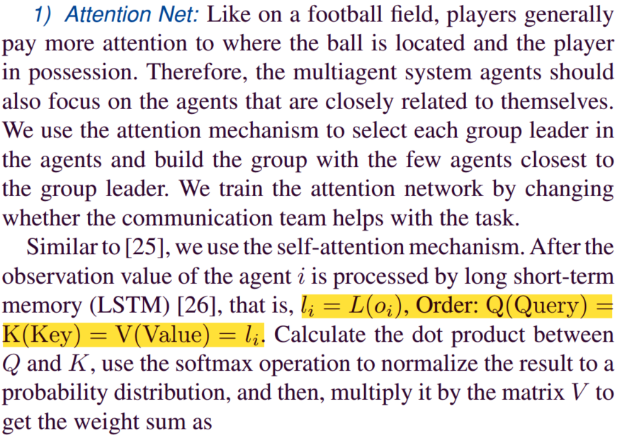
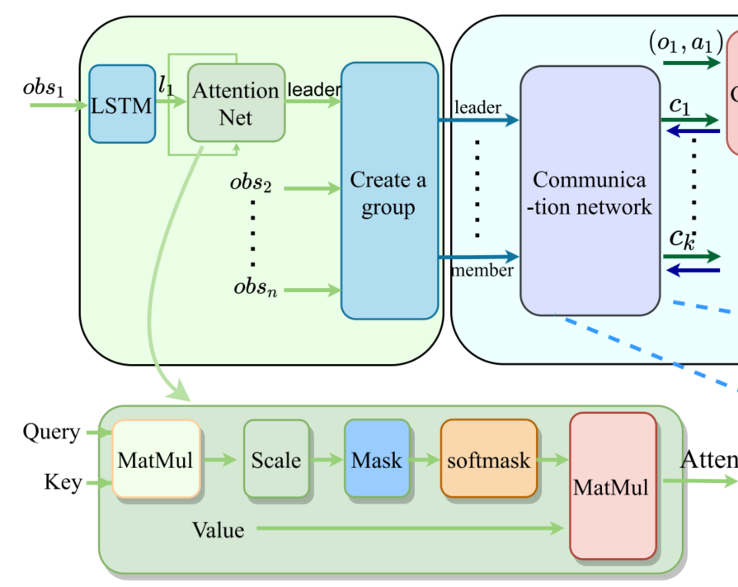
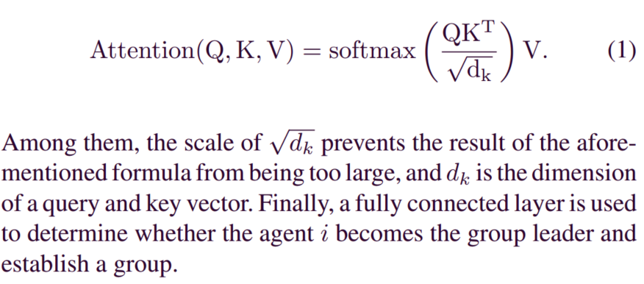
Method Design
Unlimited Dynamic Agent-Number Network (UDAN)
CPS Computational Learning Laboratory
Notes:
然后介绍第一点，无限动态智能体数网络，由注意力网络和通信网络两部分构成
首先介绍注意力网络，注意力网络采用自注意力机制，将观测经过LSTM编码后的结果li作为QKV，利用QKV计算自注意力，如公式1所示。然后将注意力输入到一个全连接层中，来决定这个智能体是否成为组长，根据他后文的内容，这个全连接层是一个二分类器，输出结果为1或者0，1的话成为组长，0的话就是不成为。

Slide 38
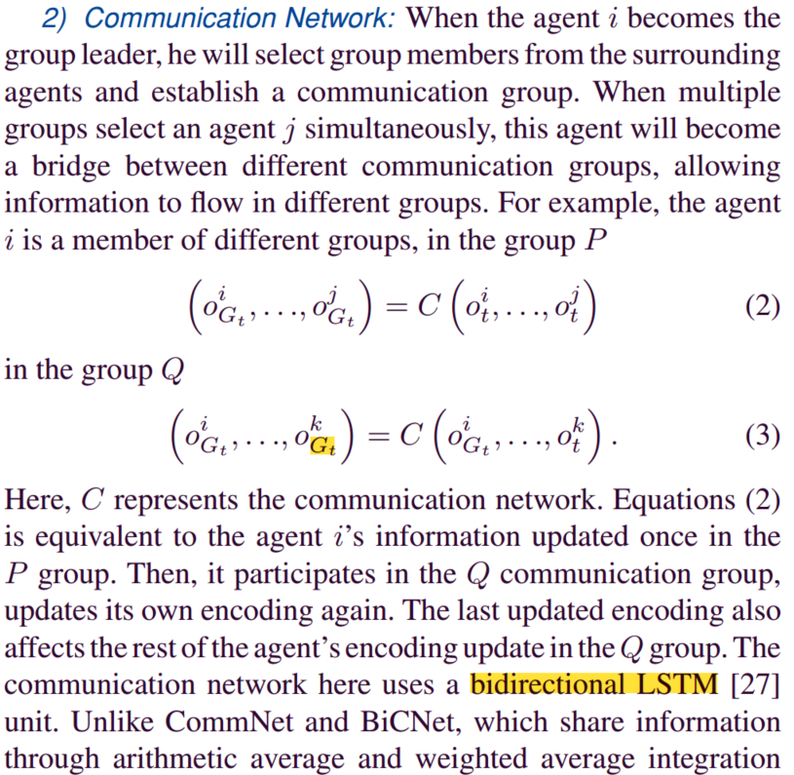
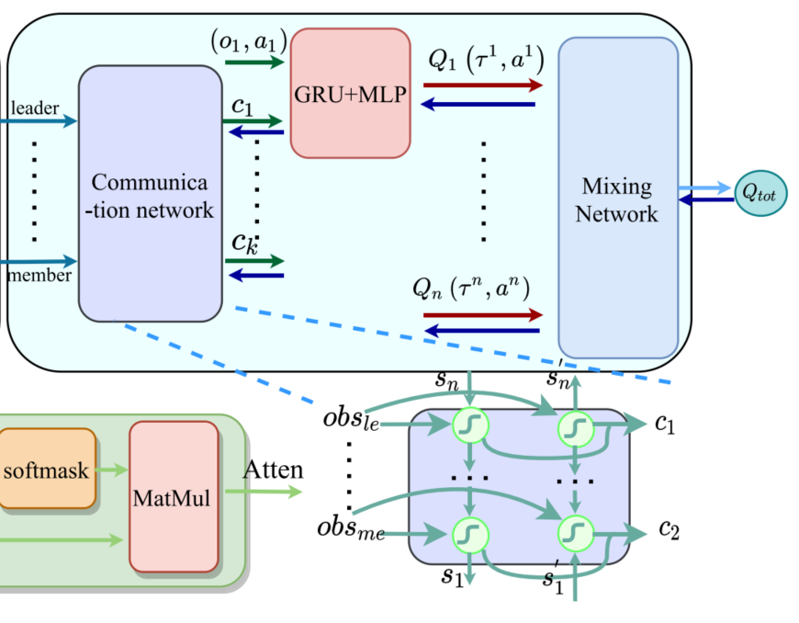
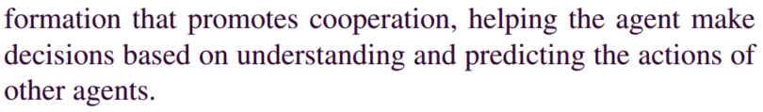
Method Design
CPS Computational Learning Laboratory
Notes:
第二部分是通信网络，本质上是一个双向LSTM。假设这个组有N个智能体，那么这个通信网络就会将这N个智能体的观测信息依次输入到这个共享的双向LSTM网络进行编码，得到的通信向量输入到智能体的局部Q网络中。
此外，这篇文章还明确了一个点，就是每个组是依次输入到通信网络中的，也就是说假设一个智能体分别在P和Q两个组内，组别Q的编号靠后，那么这个智能体的观测在组别P经过编码一次之后，在组别Q中还会经历一次编码，如公式2和3所示。

Slide 39
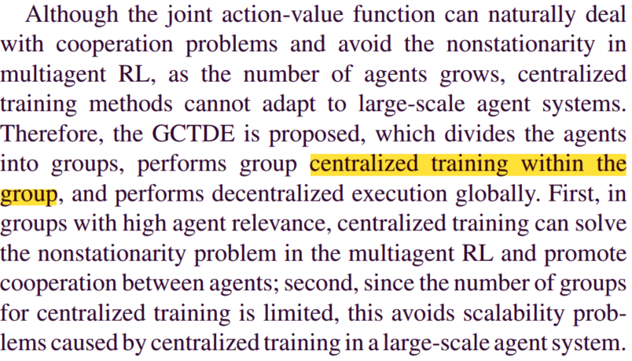
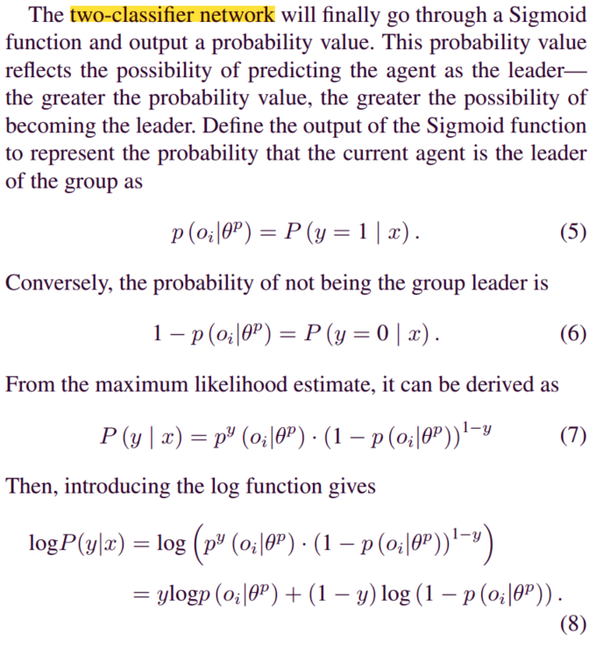
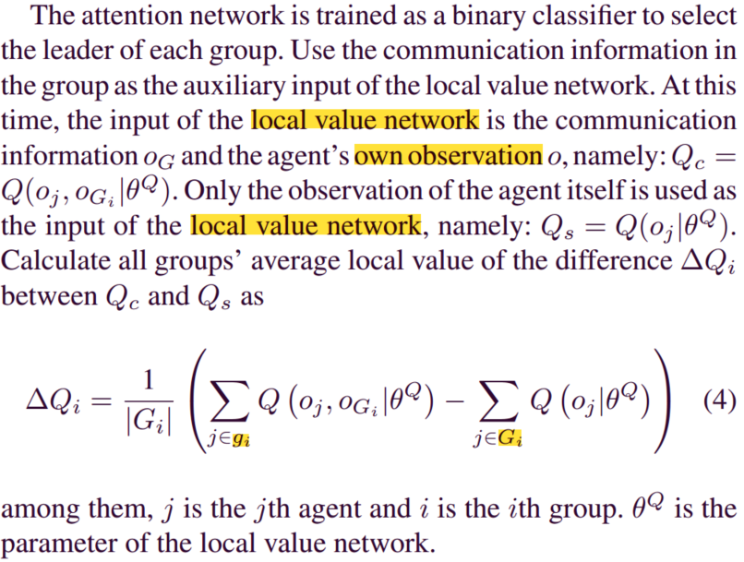
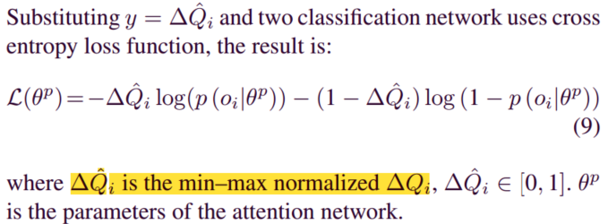
Method Design
Group Centralized Training and Decentralized Execution (GCTDE)
CPS Computational Learning Laboratory
Notes:
然后介绍这篇文章的第二个创新点，叫做组内集中训练分散执行。这个很好理解，也就是说，他不再全局计算一个联合Q值，而是每个组内计算一个联合Q值，分散执行还和普通的QMIX一样。
这里文章给出了注意力网络的训练方式，首先利用公式4来计算每个组内的个体Q值差异。然后公式5和6是代表分类结果，我前面已经说了，注意力网络最后要将注意力系数输入到一个线性层中进行分类，y=1代表组长，0则不是。公式7就是将分类结果转化为01分布，也就是伯努利分布，公式8引入对数，公式9就是将Q值差异代入到公式8中，获取注意力网络的损失函数。智能体网络的损失函数和QMIX的损失函数保持一致，这里就不列出来了。

Slide 40
01
Problem Description
02
Method Design
03
Experiment Results
Contents
04
Conclusion
CPS Computational Learning Laboratory

Slide 41
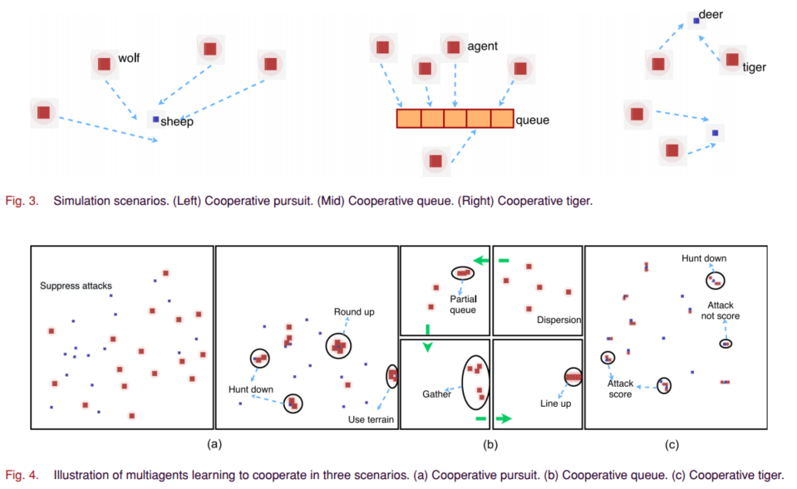
Experiment Results
CPS Computational Learning Laboratory

Slide 42
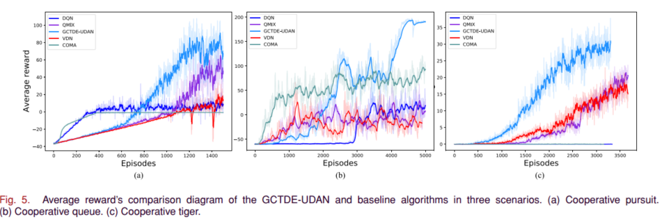
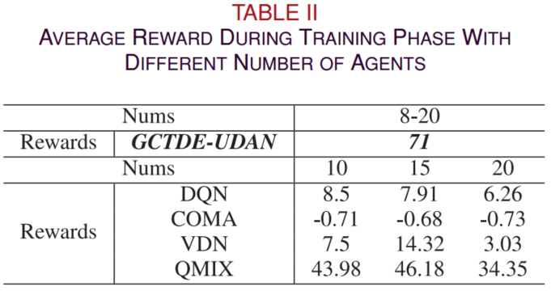


Experiment Results
CPS Computational Learning Laboratory

Slide 43
01
Problem Description
02
Method Design
03
Experiment Results
Contents
04
Conclusion
CPS Computational Learning Laboratory
CPS Computational Learning Laboratory
2
18

Slide 44
Conclusion
①
An algorithm for the centralized training within the group and global decentralized execution is proposed, which greatly reduces the cost of the centralized training in large-scale agent scenarios. Second, since the number of agents in a multiagent system is continually changing in reality, the proposed algorithm can dynamically adapt to changes in the number of agents.
②
In future work, we hope that each agent can establish groups with different numbers of members to communicate according to its state.
CPS Computational Learning Laboratory
Notes:
最后是结论，这篇文章说它们提出的架构可以减少集中训练的成本，并且能够适应智能体数量变化的场景。
在这篇文章中，每个组内智能体的数量是个固定的参数，作者希望在以后的工作中，每个智能体可以根据自己的状态建立不同成员数的通信组。

Slide 45
Paper 4
Communication-Efficient Decentralized Multi-Agent Reinforcement Learning for Cooperative Adaptive Cruise Control
Dong Chen , Member, IEEE, Kaixiang Zhang , Yongqiang Wang , Senior Member, IEEE, Xunyuan Yin , Zhaojian Li , Senior Member, IEEE, and Dimitar Filev , Life Fellow, IEEE
This paper was published in: IEEE Transactions on Intelligent Vehicles
Published Time: 2024
Reference: D. Chen, K. Zhang, Y. Wang, X. Yin, Z. Li and D. Filev, "Communication-Efficient Decentralized Multi-Agent Reinforcement Learning for Cooperative Adaptive Cruise Control," in IEEE Transactions on Intelligent Vehicles, vol. 9, no. 10, pp. 6436-6449, Oct. 2024, doi: 10.1109/TIV.2024.3368025.
CPS Computational Learning Laboratory
Notes:
用于协同自适应巡航控制具有高效通信的去中心化多智能体强化学习

Slide 46
01
Problem Description
02
Method Design
03
Experiment Results
Contents
04
Conclusion
CPS Computational Learning Laboratory
Notes:
问题描述，研究现状，方法设计，实验结果，未来工作

Slide 47
01
Problem Description
02
Method Design
03
Experiment Results
Contents
04
Conclusion
CPS Computational Learning Laboratory
Notes:
问题描述，研究现状，方法设计，实验结果，未来工作

Slide 48
Problem Description
Exist MARL methods that use centralized training and decentralized execution which require not only a centralized communication mechanism but also dense inter-agent communication during training and online adaptation.
We propose a fully decentralized MARL framework for enhanced efficiency and scalability.
A quantization-based communication scheme is proposed to reduce the communication overhead without significantly degrading the control performance. This is achieved by employing randomized rounding numbers to quantize each piece of communicated information and only communicating non-zero components after quantization.
CPS Computational Learning Laboratory
Notes:
这篇文章针对的问题是现有的多智能体强化学习方法使用集中式训练和分散式执行，这种方式不仅需要集中式通信机制，还需要密集的交互，这种要求在很多真实世界的场景中很难实现。
为此，这篇文章提出了一个完全分散的多智能体强化学习框架，以提高学习效率和可扩展性。此外，这篇文章还提出了一种基于量化的通信方法，该方法采用随机取整的方法对每一条通信信息进行量化，只传输量化后非0的信息，从而在不显著降低控制性能的情况下减少通信开销。

Slide 49
01
Problem Description
02
Method Design
03
Experiment Results
Contents
04
Conclusion
CPS Computational Learning Laboratory
Notes:
研究现状

Slide 50




Method Design
Fully Decentralized MARL
CPS Computational Learning Laboratory
Notes:
这篇文章是讲应用的，毕竟我不做什么自适应巡航控制，我就直接讲这篇文章的算法设计部分，前面的一些问题建模我就省略了。
首先介绍这篇论文提出的完全去中心化的多智能体强化学习框架，公式7是actor网络的损失函数，也就是经典的策略损失，公式8是critic网络的损失函数，也是经典的值函数损失框架。到此为止，这篇论文提出的方法就是对每个智能体用一个actor-critic框架。
每个智能体共享奖励，就是奖励和的平均值。这里，这篇文章提出了一个很有意思的点，也就是它的通信不像其他几篇文章那样共享观测信息，这篇文章对critic网路进行操作，它共享值函数信息。他把critic网络的输出也就是值函数表示为x，利用邻域内信息共享的思想，对邻域内所有值函数求均值。在共享值函数的基础上，这篇文章提出了公式9，值函数加权共享。值函数共享与普通的观测共享最大的区别是，值函数共享是发生在训练过程中的，而观测共享是发生在执行过程中的，因此，你可以看到公式9中并没有时间t的概念，而是换成了训练的step k。第k+1次迭代的值函数是由k次迭代的值函数以及邻域内其他智能体的值函数构成。w代表代数图论中的邻接矩阵，类似于布尔通信逻辑，如果智能体i和j之间存在通信通道，即存在一条边，那么矩阵w中相应位置为1，反之为0，g代表梯度。

Slide 51





Method Design
Quantization-Based Communication Protocol
CPS Computational Learning Laboratory
Notes:
讲完了这篇问题提出的完全去中心化框架，接下来讲他在这个框架下做的基于量化的通信协议
这篇文章用Q(x)表示对值函数x进行量化操作的函数。量化结果是一组参数向量，表示为小q。量化操作如公式10所示。其中r这里说是一个不小于x的无穷范数的实数，我读完整篇文章后，感觉r的取值就是x的无穷范数，也就是向量x中最大的数字。sign函数用来提取x的符号，b是从集合{0, 1/n, 2/n,...1}集合中采样的一个实数，n是量化的分辨率，是个超参数。m是一个大于等于0小于等于n-1的一个随机整数，也就是前面摘要里提到的随机取整操作。通过上述操作，Q函数讲x的绝对值限制在mr/n到(m+1)r/n之间，如图3所示。请注意，这里是个闭区间，也就是说两端的值是可以取到的，当然，这篇论文只能使x取两端的值，因为公式11a到11c表述了取两端值的概率和为1，而取中间值的概率为0，这样就完成了参数量化编码。公式12a和12b是对公式11a和11b的简化版本。最后利用右下角的公式来更新值函数的估计，这个公式就是在之前公式9里的邻域值函数估计共享的基础上添加了量化操作。

Slide 52
01
Problem Description
02
Method Design
03
Experiment Results
Contents
04
Conclusion
CPS Computational Learning Laboratory

Slide 53

Experiment Results
CPS Computational Learning Laboratory

Slide 54

Experiment Results
CPS Computational Learning Laboratory
Notes:
在星际争霸和谷歌足球中的实验

Slide 55

Experiment Results
CPS Computational Learning Laboratory

Slide 56
01
Problem Description
02
Method Design
03
Experiment Results
Contents
04
Conclusion
CPS Computational Learning Laboratory
CPS Computational Learning Laboratory
2
18

Slide 57
Conclusion
①
This novel approach eliminated the need for a centralized controller during both training and execution, thereby enhancing the system’s scalability and robustness;
An innovative quantization-based communication protocol was introduced to significantly enhance the communication efficiency among the agents;
②
Our future study aims to explore the resilience of MARL in the face of potential cyber-attacks and uncertainties.
CPS Computational Learning Laboratory
Notes:
这篇论文提出的方法在训练和执行过程中消除了对集中控制器的需要，从而提高了系统的可扩展性和鲁棒性：此外，这篇论文引入了一种基于量化的通信协议，提高了代理之间的通信效率;
未来的研究旨在探索MARL在面对潜在网络攻击和不确定性时的恢复能力。

Slide 58
Paper 5
NVIF: Neighboring Variational Information Flow for Cooperative Large-Scale Multiagent Reinforcement Learning
Jiajun Chai , Graduate Student Member, IEEE, Yuanheng Zhu , Senior Member, IEEE, and Dongbin Zhao , Fellow, IEEE
This paper was published in: IEEE Transactions on Neural Networks and Learning Systems
Published Time: 2024
Reference: J. Chai, Y. Zhu and D. Zhao, "NVIF: Neighboring Variational Information Flow for Cooperative Large-Scale Multiagent Reinforcement Learning," in IEEE Transactions on Neural Networks and Learning Systems, vol. 35, no. 12, pp. 17829-17841, Dec. 2024, doi: 10.1109/TNNLS.2023.3309608.
CPS Computational Learning Laboratory
Notes:
协同大规模多智能体强化学习的邻域变分信息流

Slide 59
01
Problem Description
02
Method Design
03
Experiment Results
Contents
04
Conclusion
CPS Computational Learning Laboratory
Notes:
问题描述，研究现状，方法设计，实验结果，未来工作

Slide 60
01
Problem Description
02
Method Design
03
Experiment Results
Contents
04
Conclusion
CPS Computational Learning Laboratory
Notes:
问题描述，研究现状，方法设计，实验结果，未来工作

Slide 61
Problem Description
The existing methods have limitations in large-scale multiagent systems due to high information redundancy, and they tend to overlook the unstable training process caused by the online-trained communication protocol.
We propose a novel method called neighboring variational information flow (NVIF), which enhances communication among neighboring agents by providing them with the maximum information set (MIS) containing more information than the existing methods.
CPS Computational Learning Laboratory
Notes:
现有的方法在大规模多智能体系统中由于高信息冗余而存在局限性，并且它们往往忽略了由在线训练的通信协议引起的不稳定的训练过程。为此，这篇论文的作者提出了一种新的方法叫做邻域变分信息流（NVIF）方法，该方法通过向邻近智能体提供包含比现有方法更多信息的最大信息集（MIS）来增强邻近智能体之间的通信。

Slide 62
01
Problem Description
02
Method Design
03
Experiment Results
Contents
04
Future Work
CPS Computational Learning Laboratory
Notes:
研究现状

Slide 63




Method Design
Neighboring Variational Information Flow
CPS Computational Learning Laboratory
Notes:
这篇论文把智能体i从时间步0到时间步t能够接收到的信息做成了一个集合hit，也就是他说的最大信息集合MIS，如公式5所示。它是由图2中的多轮信息聚合得到的。图2中的展示类似于图神经网络的信息聚合。I代表每个智能体能够分享的消息，Nkj代表任意智能体在k时间步的邻居集合。
首先从t=0时分析，此时智能体i只能获得邻居和自身的信息。t=1时，智能体i能获取t=1时刻邻居和自身的消息，也就是第一项；以及t=0时已经获取的信息，也就是第二项；由于t=0时邻居也聚合了自身邻居的消息，如β0所示，那么这个第二项可以改写为智能体i在t=1时刻聚合了自身以及邻居在t=0时的消息。然后以此类推，就能得到公式6。公式6被分为2部分，第一部分是智能体i和邻居在从0到t-1时刻的最大消息集合的集合，第二项为智能体i和其邻居在t时刻聚合的消息。

Slide 64




Method Design
CPS Computational Learning Laboratory
Notes:
作者认为hi，t中包含冗余信息。因此引入VAE模块来提高通信效率。编码器部分将hi，t中的信息压缩成潜在状态shat，如公式7所示。也就是变分自编码器VAE编码器部分的输出。
然后是VAE的解码器部分，解码器的输入为潜在状态shat，以及x，这里的x是每个智能体独一无二的信息，文章中设置为每个智能体的位置。然后解码器的输出为观测的预测值，也就是说VAE对观测信息做了个重构。
利用公式8来训练VAE，公式8分为两个部分，第一个是利用二元交叉熵损失获取的重构损失，第二个是先验分布与推断分布的KL散度损失。
作者说，利用公式8直接作为损失函数的话，可能会导致shat变为局部观测信息，为了使当前潜在状态具备全局信息，作者信息智能体i的潜在状态与其他智能体的潜在状态类似，希望能用局部潜在状态表示全局信息。因此作者采用智能体i自身的潜在状态以及其他智能体潜在状态的均在做了一个MSE损失。并将公式8和9加权求和。

Slide 65





Method Design
Training Algorithm of NVIF
CPS Computational Learning Laboratory
Notes:
这篇文章采用GCN来进行信息聚合，GCN每层信息聚合如公式11所示。GCN和两个神经网络组合成一个模块，叫做FlowNet，如图c所示。
将观测以及最大信息集合的集合通过FlowNet进行多轮信息聚合，得到两个phi，如公式12所示。将两个ohi输入到GRU中，得到GRU的隐藏状态，这个GRU的隐藏状态就是t时刻的最大信息集合，如公式13所示。然后把这个ht拆成两个维度相等的特征输入到一个可学习的高斯分布N中，然后采样得到潜在状态shat。然后将这个潜在状态shat与智能体位置x输入到解码器中，得到观测的重构ohat，如公式15所示。整个流程如图a所示。

Slide 66



Method Design
CPS Computational Learning Laboratory
Notes:
为了得到离线数据集，这篇首先执行随机策略以与环境交互，将观测值、位置和邻接矩阵存储在存储器缓冲器中。然后，使用上述前向规则来计算重构观测，并优化VAE的参数。通过迭代Mnvif中的所有片段，完成一个训练时期。
在对VAE模块进行预训练后，我们使用其编码器部分作为多智能体系统的通信协议。用一句话概括就是，先随机采样环境数据训练VAE，然后训练好的编码器再用到MARL中，进行在线学习。

Slide 67
01
Problem Description
02
Method Design
03
Experiment Results
Contents
04
Conclusion
CPS Computational Learning Laboratory

Slide 68


Experiment Results
CPS Computational Learning Laboratory

Slide 69

Experiment Results
CPS Computational Learning Laboratory

Slide 70
01
Problem Description
02
Method Design
03
Experiment Results
Contents
04
Conclusion
CPS Computational Learning Laboratory
CPS Computational Learning Laboratory
2
18

Slide 71
Conclusion
①
The proposed method utilizes neighboring communication and provides agents with more information by providing MIS, which is compressed into a compact latent state to further mitigate the information redundancy by the proposed NVIF module.
②
To further enhance the communication efficiency, future work can investigate the development of an efficient communication protocol and graph structure from the offline dataset.
CPS Computational Learning Laboratory
Notes:
所提出的方法利用相邻通信，通过提供最大信息集合，并使用VAE将最大信息集合压缩成一个紧凑的潜在状态，以进一步减轻通信模块的冗余信息。
未来的工作科研从离线的数据集中开发更高效的通信协议

Slide 72
Research Inspiration
Communication does not necessarily involve observational information; communication can also be a value function estimate. Current mainstream research on multi-agent communication typically employs graph neural networks for small-scale systems and graph theory or recurrent networks for large-scale systems.
CPS Computational Learning Laboratory
Notes:
通信不一定非得是观测信息，也可以是值函数估计；目前多智能体通信的主流研究小规模一般使用图神经网络，大规模一般使用图论或者循环网络。

Slide 73
Thank you for listening
CPS Computational Learning Laboratory
108
Notes:
感谢老师同学观看，请各位老师同学批评指正

